Slide 1
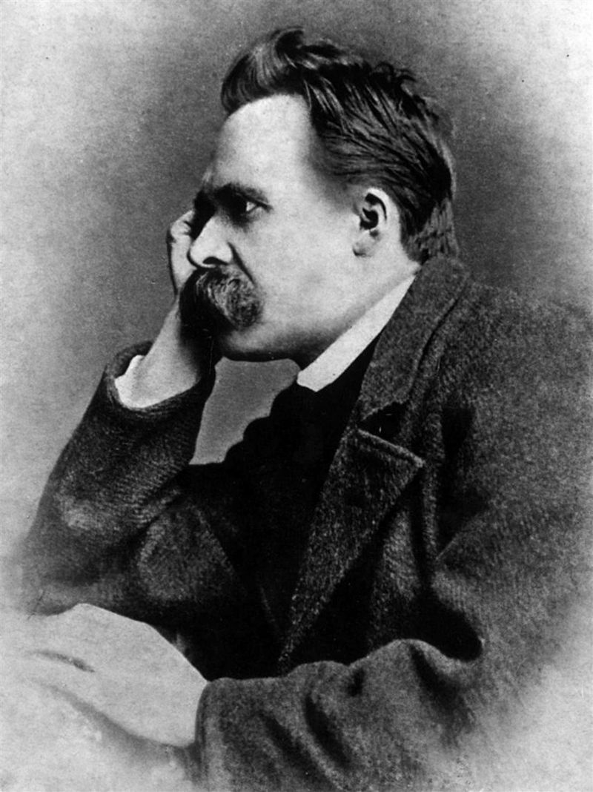
God is dead.

Slide 2
God is dead.

