Slide 1
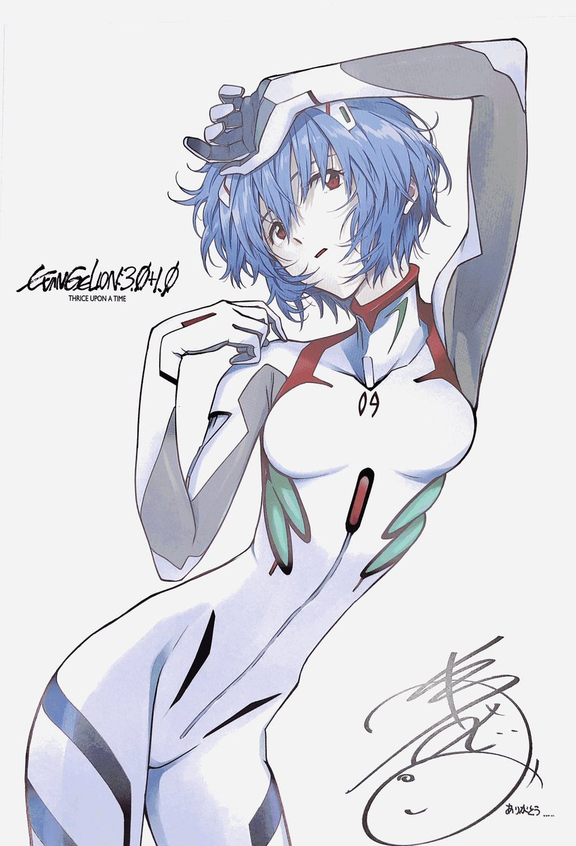
THRICE UPON A TIME

Slide 2
THRICE UPON A TIME

Slide 3
THRICE UPON A TIME

