Slide 1
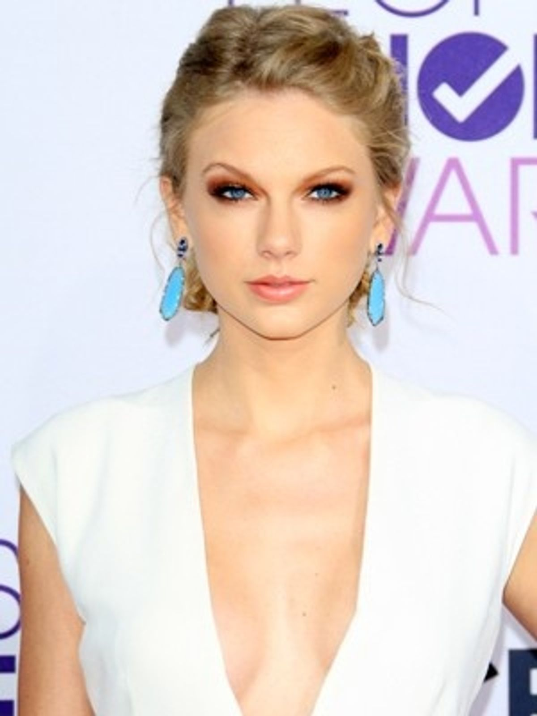
Taylor Alison Swift

Slide 2
Taylor Alison Swift

