Slide 1
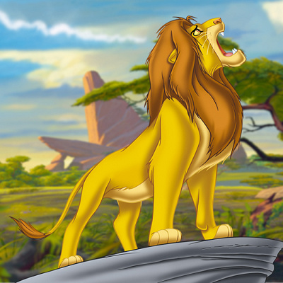
LION SONG

Slide 2
LION SONG

Slide 4
